Slide 1
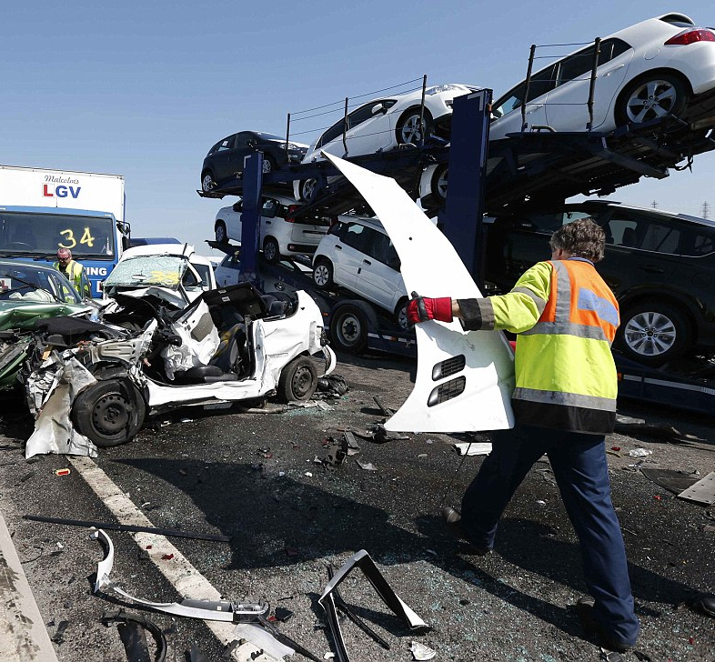
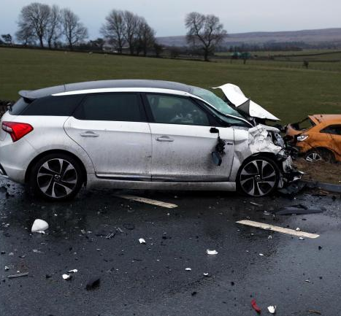
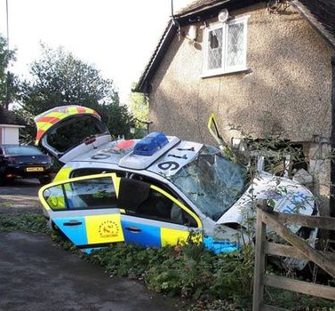
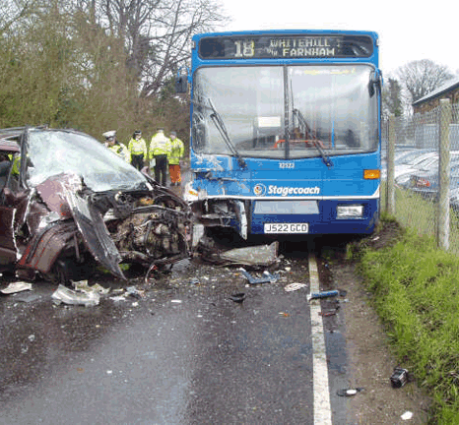
Fatal Accidents in UK
Prediction Model

Slide 2

Presentation Layout
Introduction
Research Question
Data Exploration
Prediction Model Selection
Practical use of the Selected Model
Weak Points and Shortcomings

Slide 3
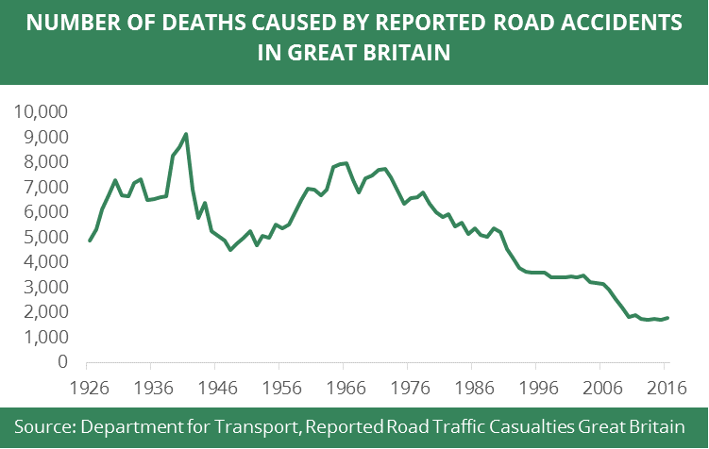
Introduction
Approximately 250,000 accidents occurred between 2010 and 2014 in UK is included in this study.
This data is published by Steafno Leone on Kaggle 6 months ago. No information about the method used for data collection.
The data is clean with no missing variables

Slide 4

Data
Hours in the data frame were decimal from 0.001 to 0.99. It has been multiplied by 24 to be in the 24-hour format.
Many columns values which are numeric in the data frame has been switched to string because it is categorical.

Slide 5
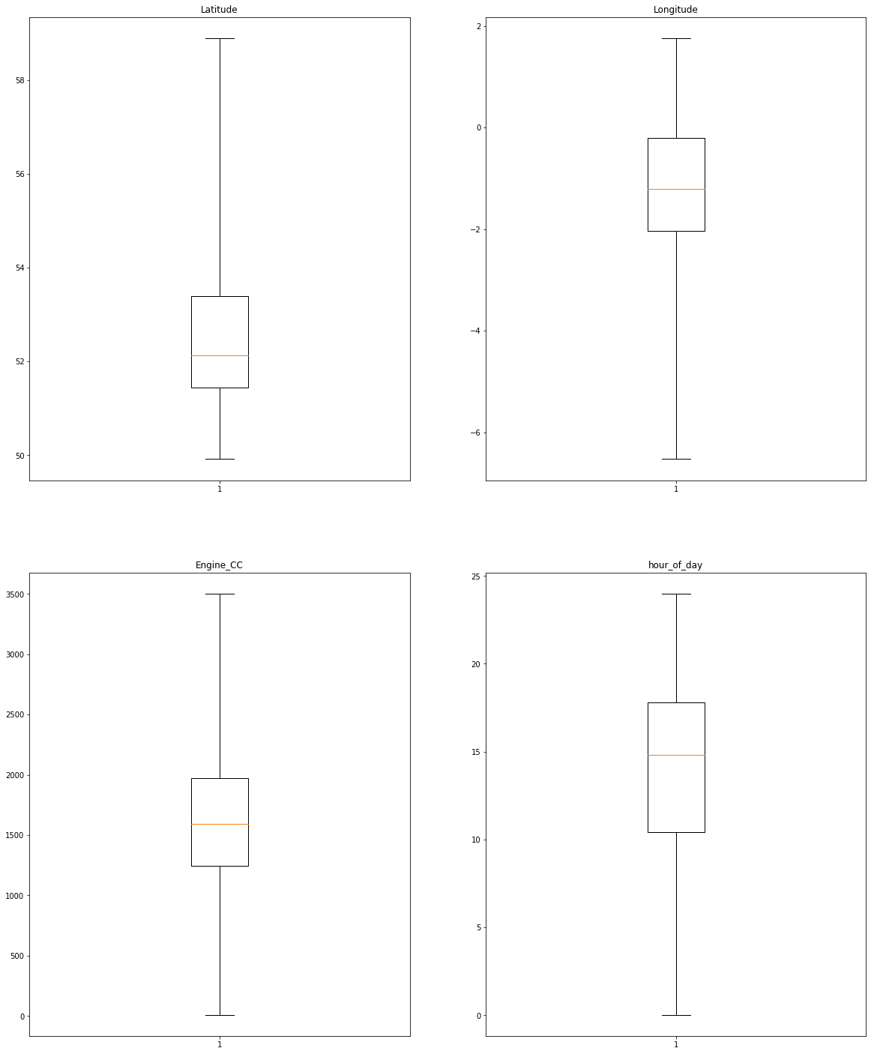
Outliers
No outliers as shown in the Box Plot.

Slide 6

Research Questions
What is the important features that can predict fatal and serious accidents?
How accurate can we predict fatal and serious accidents?
What is the best prediction model?

Slide 7

Data Exploration
Univariate Analysis for target Variable (Accident Severity)
Bivariate Analysis for prediction features grouped into 5 main groups:
Time
Location
Vehicle
Driver
Road, Weather and Accident Conditions

Slide 8
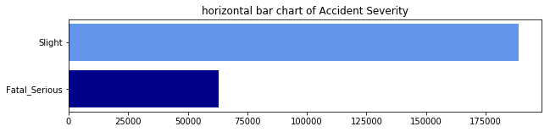
Univariate Analysis
The Target Variable in this analysis is binary (Fatal Serious, Slight)
Most of the accident in this study are slight accidents (75.06%)

Slide 9
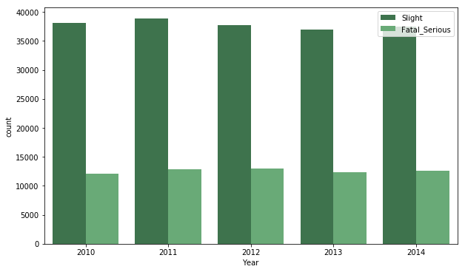
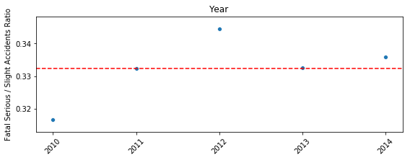
Time Related Features (Year)
Total number of accidents did not change too much during the 5 years
There is no trend for increasing or decreasing accident severity over time

Slide 10
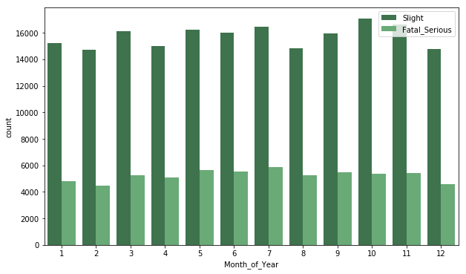
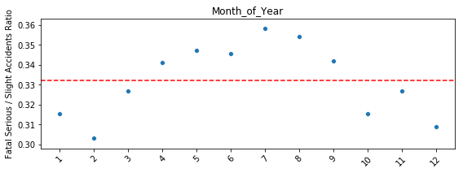
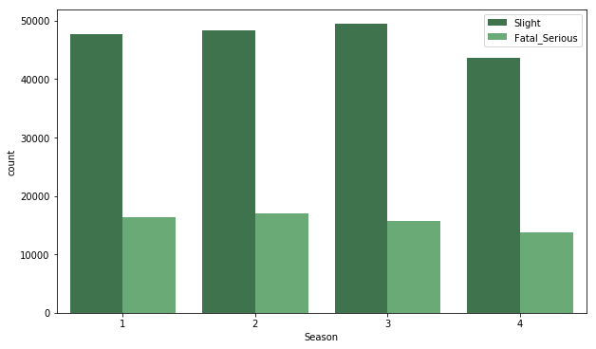
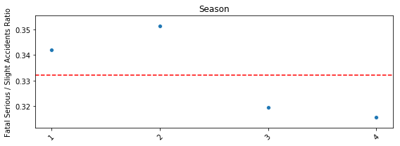
Time Related Features (Season)
Accidents slightly decrease during Winter season compare to the rest of the year
Accidents severity is higher during summer and spring compare to winter and fall

Slide 11
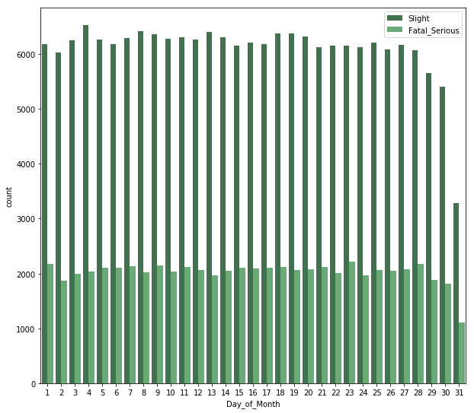
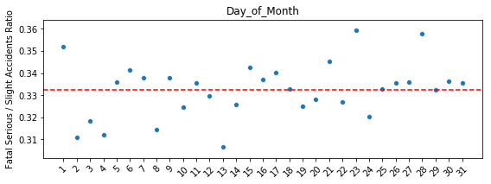
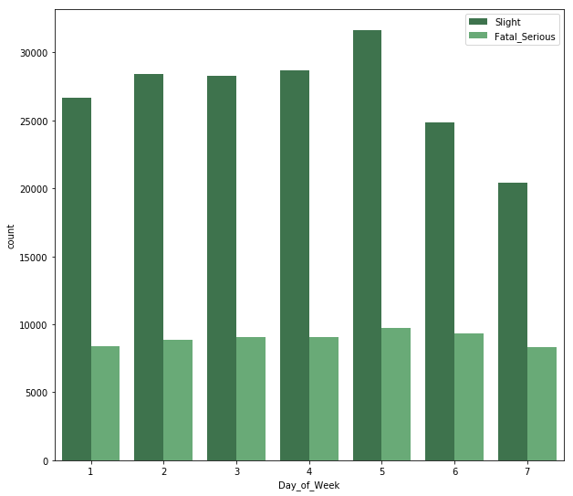
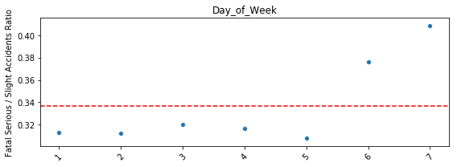
Time Related Features (Day)
Accidents decreases during weekend compare to weekdays, but the severity increases.
Accidents occurrence and severity does not change much during the month.

Slide 12
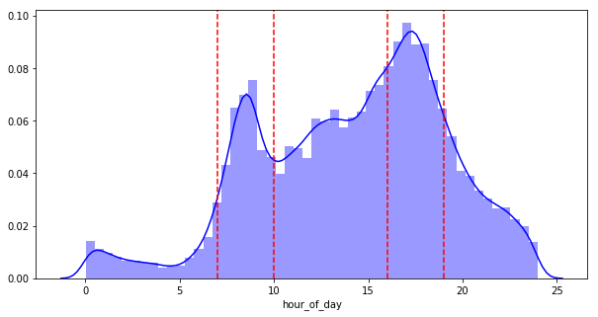
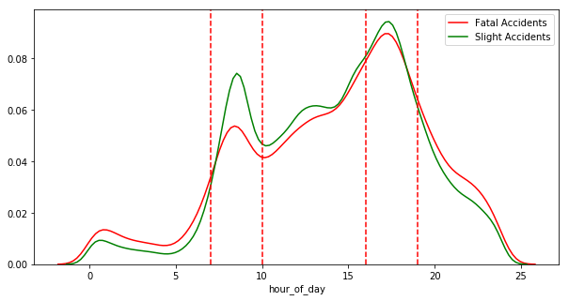
Time Related Features (Hour)
Accidents occur more during daytime and reach its peak during rush hours
The distribution of fatal accidents spread more during late nigh and early morning hours compare to the slight accidents.

Slide 13



Time Related features (Selected Features)
Season, Day of Week, Hour of Day

Slide 14
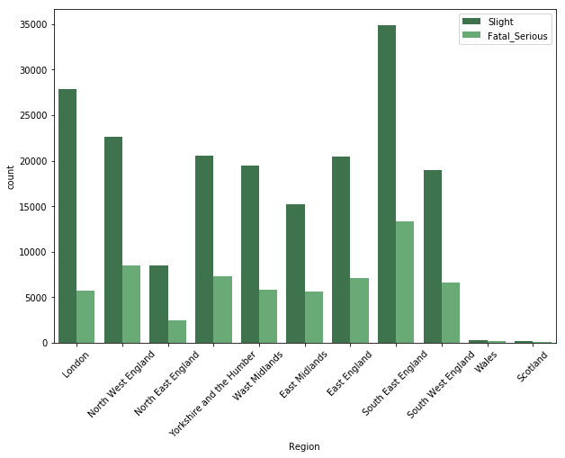
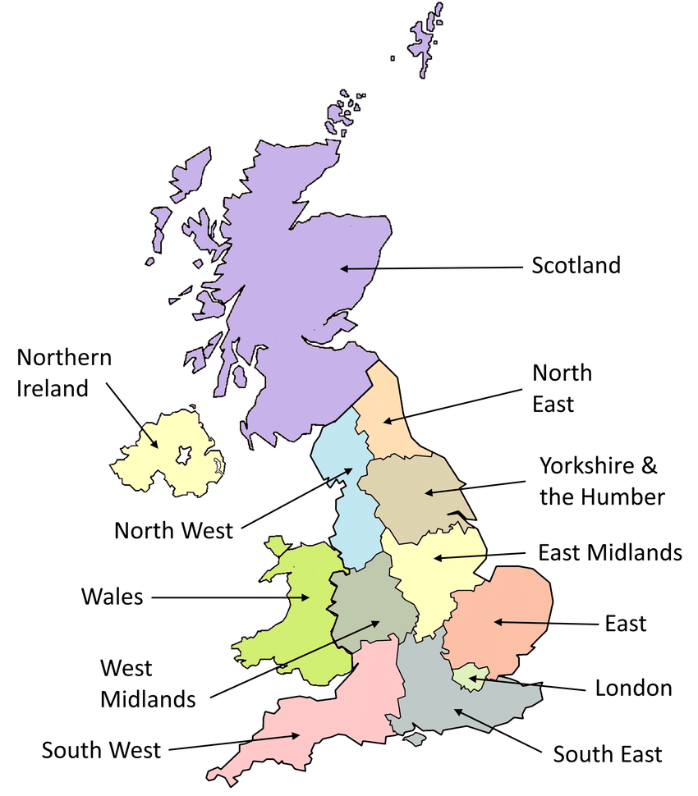
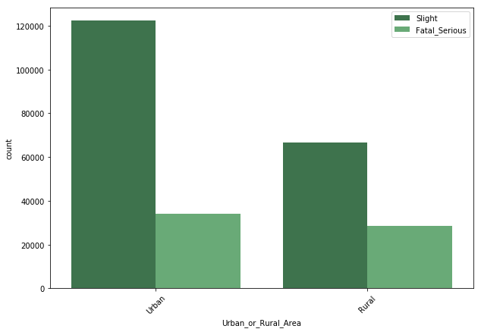
Location Related Features (Area)
Accidents are more at South East England
Accidents are high in London, but severity looks very low
Accidents are more in urban areas, but severity is higher in rural areas

Slide 15
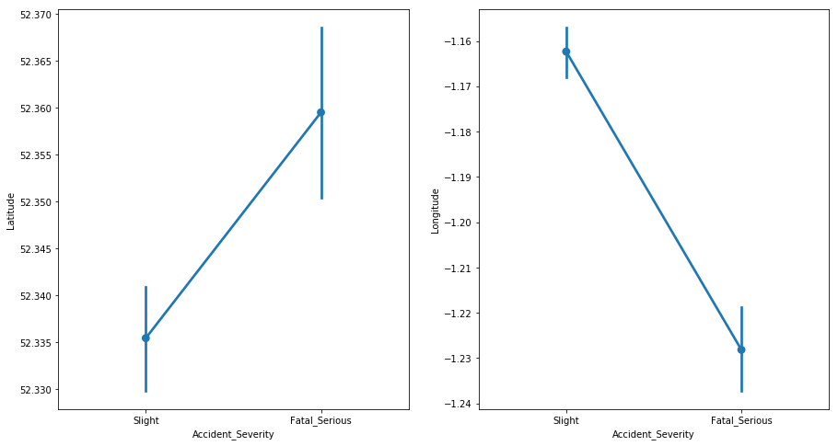
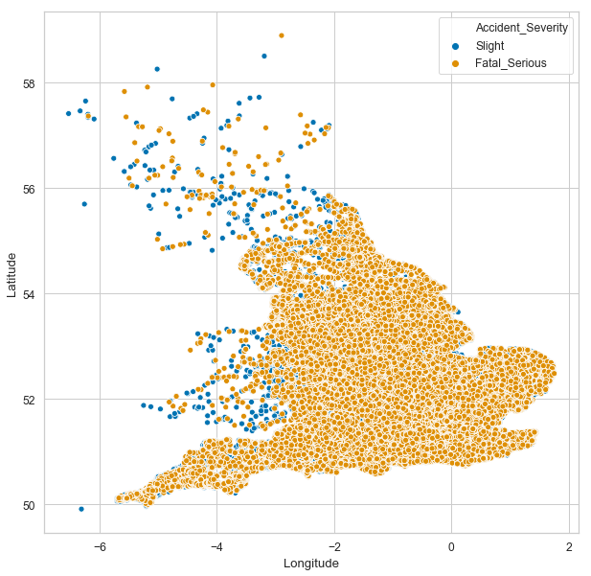
Location Related Features (Coordinates)
T-test revealed that accident severity is significantly different as the longitude and latitude changes.

Slide 16


Location Related features (Selected Features)
Urban or Rural
Latitude
Longitude

Slide 17
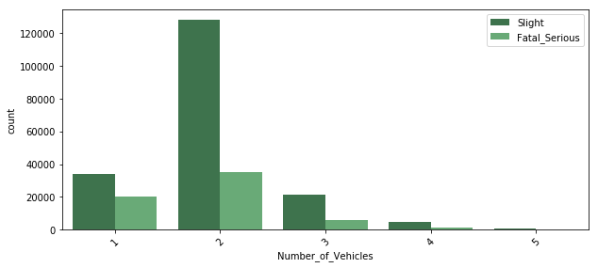
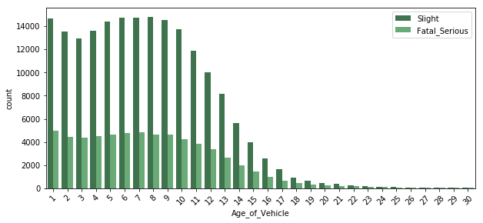
Vehicle Related Features (Number and Age)
Most of the vehicles involved in the accidents are less than 10 years old
As the vehicles gets older, the number of accidents decrease, and severity of the accidents increase.
Most of the accidents involve 2 vehicles, but the severity is significantly higher if only 1 vehicles is involved in the accident.

Slide 18
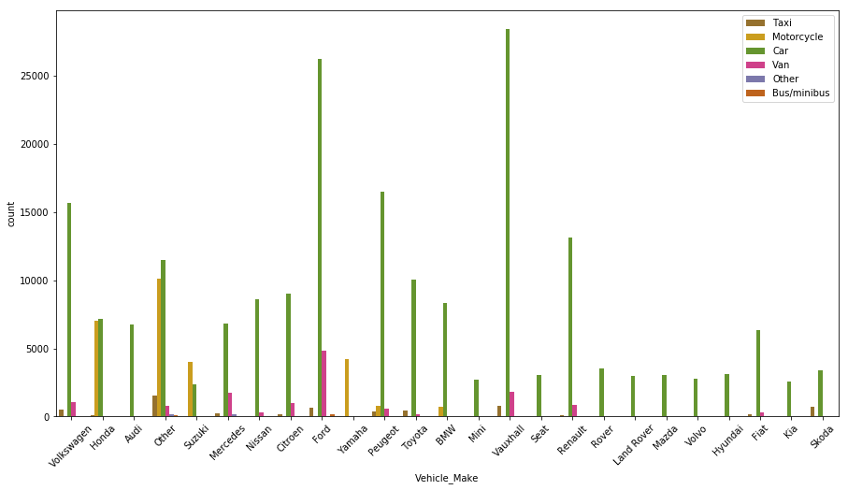
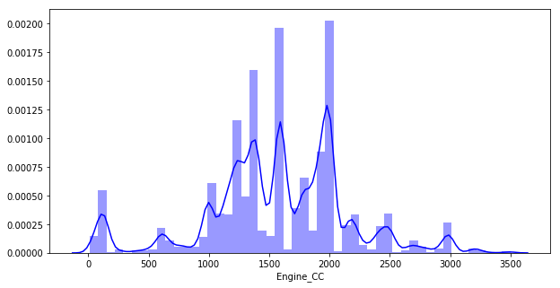
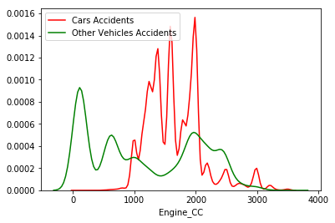
Vehicle Related Features (Vehicle Spec.)
Most of the accidents involve cars. Motorcycles have the highest accident severity.
Manufactures such as (Yamaha, Honda, Suzuki) have a high severity rate because they product motorcycles.
Most of the motorcycles have a lower engine cc compare to cars and that is why the t-test shows accidents are more sever when the cc of the vehicle is lower.

Slide 19

Vehicle Related Features (Selected Features)
Engine CC

Slide 20
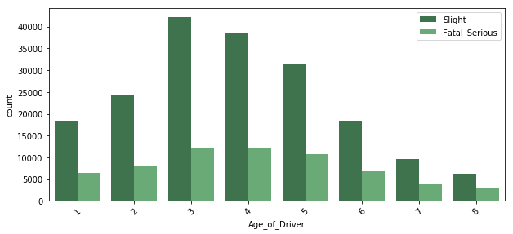
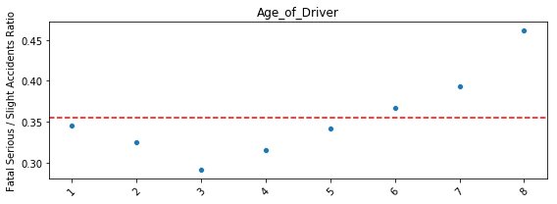
Driver Related Features (Age)
Most of the accidents happened to drivers aged between 30 and 59 years old.
Severity of the accidents is the lowest for 30-39 age group and increase as the driver gets older and the number of accidents decreases as well.

Slide 21
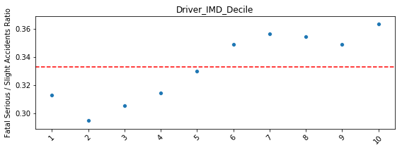
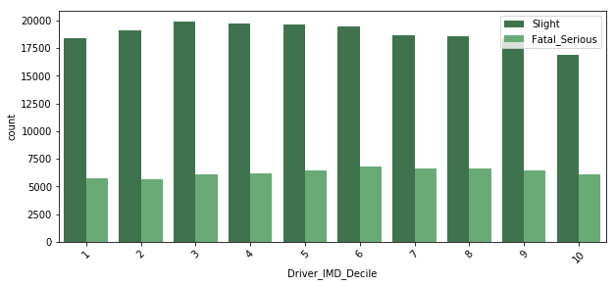
Driver Related Features (Economic/Social)
Using Driver IMD Decile Index, drivers are divided into 10 groups based on their economic and social status.
No big difference in number of accidents but the severity of the accidents increases more with the drivers who have economic and social advantage

Slide 22
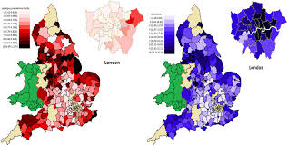

Driver Selected Features
Age of Driver
Driver IMD Decile

Slide 23
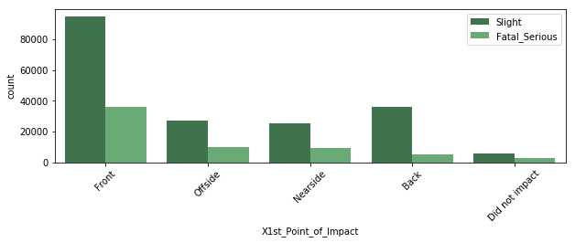
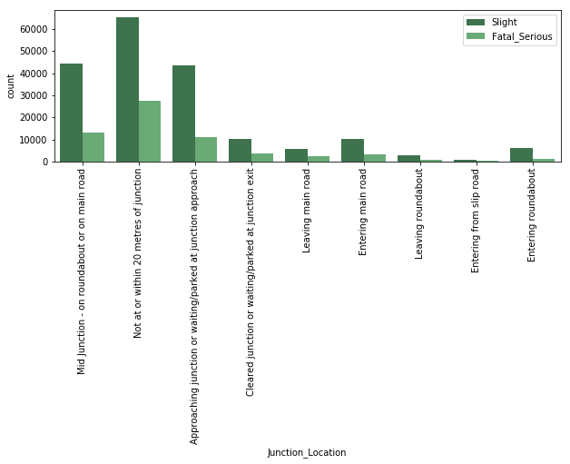
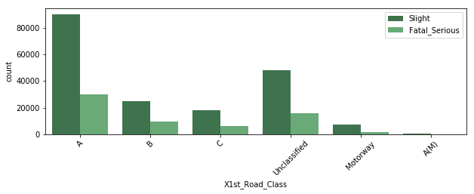
Road, Weather and Accident Conditions (Selected Features)

Slide 24
List of Selected Features
Season
Day of Week
Hour of Day
First point of impact
Road class
Junction location
Engine CC
Target Variable:
Accident Severity (Slight, Fatal serious)
latitude
longitude
Urban or rural
Age of driver
Driver imd decile

Slide 25
Prediction Model Selection
Model | Accuracy (Mean Cross-Validation) | Precision | Recall | F1-Score
Naïve Bias | 0.7387 | 0.43 | 0.12 | 0.19
KNN | 0.7171 | 0.36 | 0.18 | 0.24
Logistic Regression | 0.7514 | 0.71 | 0.00 | 0.01
Random Forest | 0.7390 | 0.46 | 0.17 | 0.25
Gradient Boosting | 0.7545 | 0.63 | 0.05 | 0.09

Slide 26
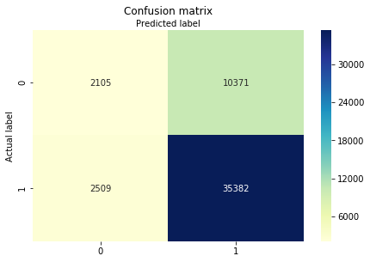
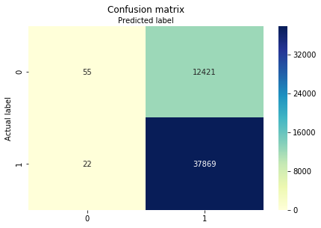
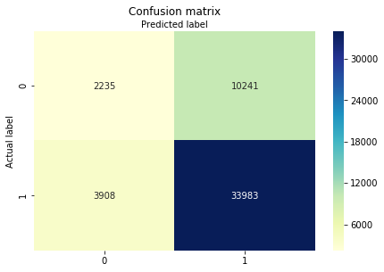
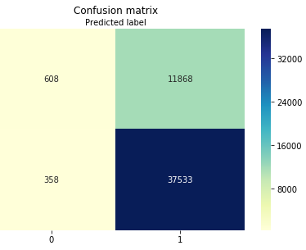
Prediction Model Selection
Random Forest
Logistic Regression
KNN Neighbor
Gradient Boosting

Slide 27
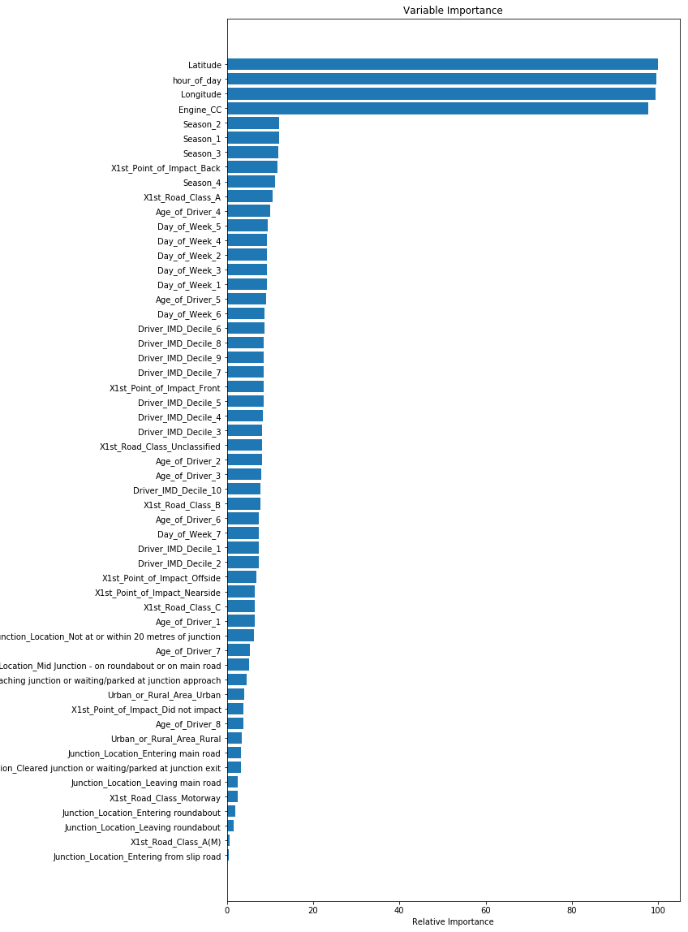
Feature Importance
Features with relative importance higher than 20% was considered in the rendered Random Forest Model.

Slide 28

Random Forest Model 2
Features {Latitude, Longitude, Hour of day, Engine CC)
Model accuracy slightly decreased to 0.7211
Precession, Recall and F-Value increased

Slide 29
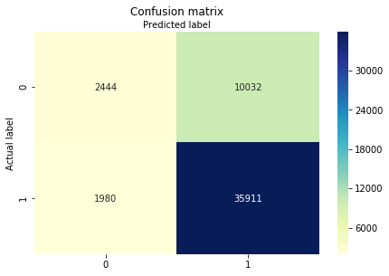
Random Forest Model 3
Number of estimators has been increased from 20 to 100
Model accuracy slightly increase to 0.7369
Precession increased to 0.55 but Recall and F-Value values decreased to 0.20 and 0.29.

Slide 30
Random Forest Model 4
Criterion has been changed from ‘Gini’ to ‘entropy’ while keeping number of estimators = 20.
Features with relative importance higher than 10% and less than 20% has been included in the model.
Model accuracy slightly higher (0.7270) than Random Forest Model 2 accuracy.
Precession, Recall and F-Value values are lower than Random Forest Model 2 values.

Slide 31

Selected Model (Random Forest 2)
This model has been selected because it achieved the highest F1-value for fatal Serious accident severity.
The accuracy was not different from all other models
Precession, Recall, and F-1 values are important because it is more important for us to correctly identify Fatal and serious accidents than correctly identify slight accidents.

Slide 32
Practical use of the Selected Model
By identifying the important features, you can predict the locations with high potential of fatal accident occurrence.
This model also help in identifying the hours with high accident occurrence and the most dangerous accidents.
Model can be used to generate simulation and try to change features by planned improvement plans and check the results.
The model can be used by Emergency to predict the severity of the accidents based in the information and assign the adequate resources.
This model can be the start of building more precise and accurate models by running the analysis on specific regions independently or specific cities or towns in the regions.

Slide 33
Weak Points and Shortcomings
Model prediction accuracy, precession and recall is relatively low, but predicting fatal accidents is not easy when you run the analysis on the entire country.
Many features has been withdrawn from the analysis due to high class imbalance. Including these features (if no imbalance is there) could add value.
The data of this analysis is outdated more than 5 years ago and might not be valuable in 2019, even though the number of fatal accidents in UK were steady during the last 8 years.

Slide 34


Slide 35
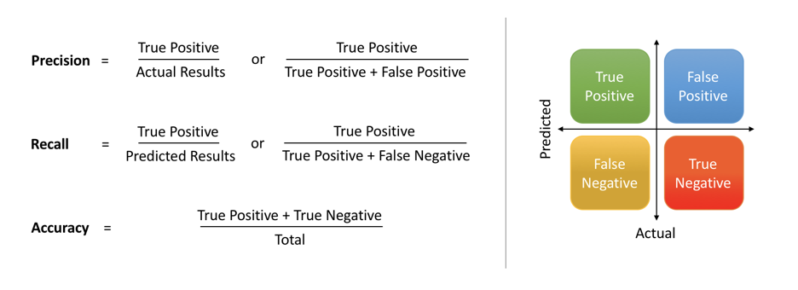

Extra: Metrics for Model Selection

